Slide 1
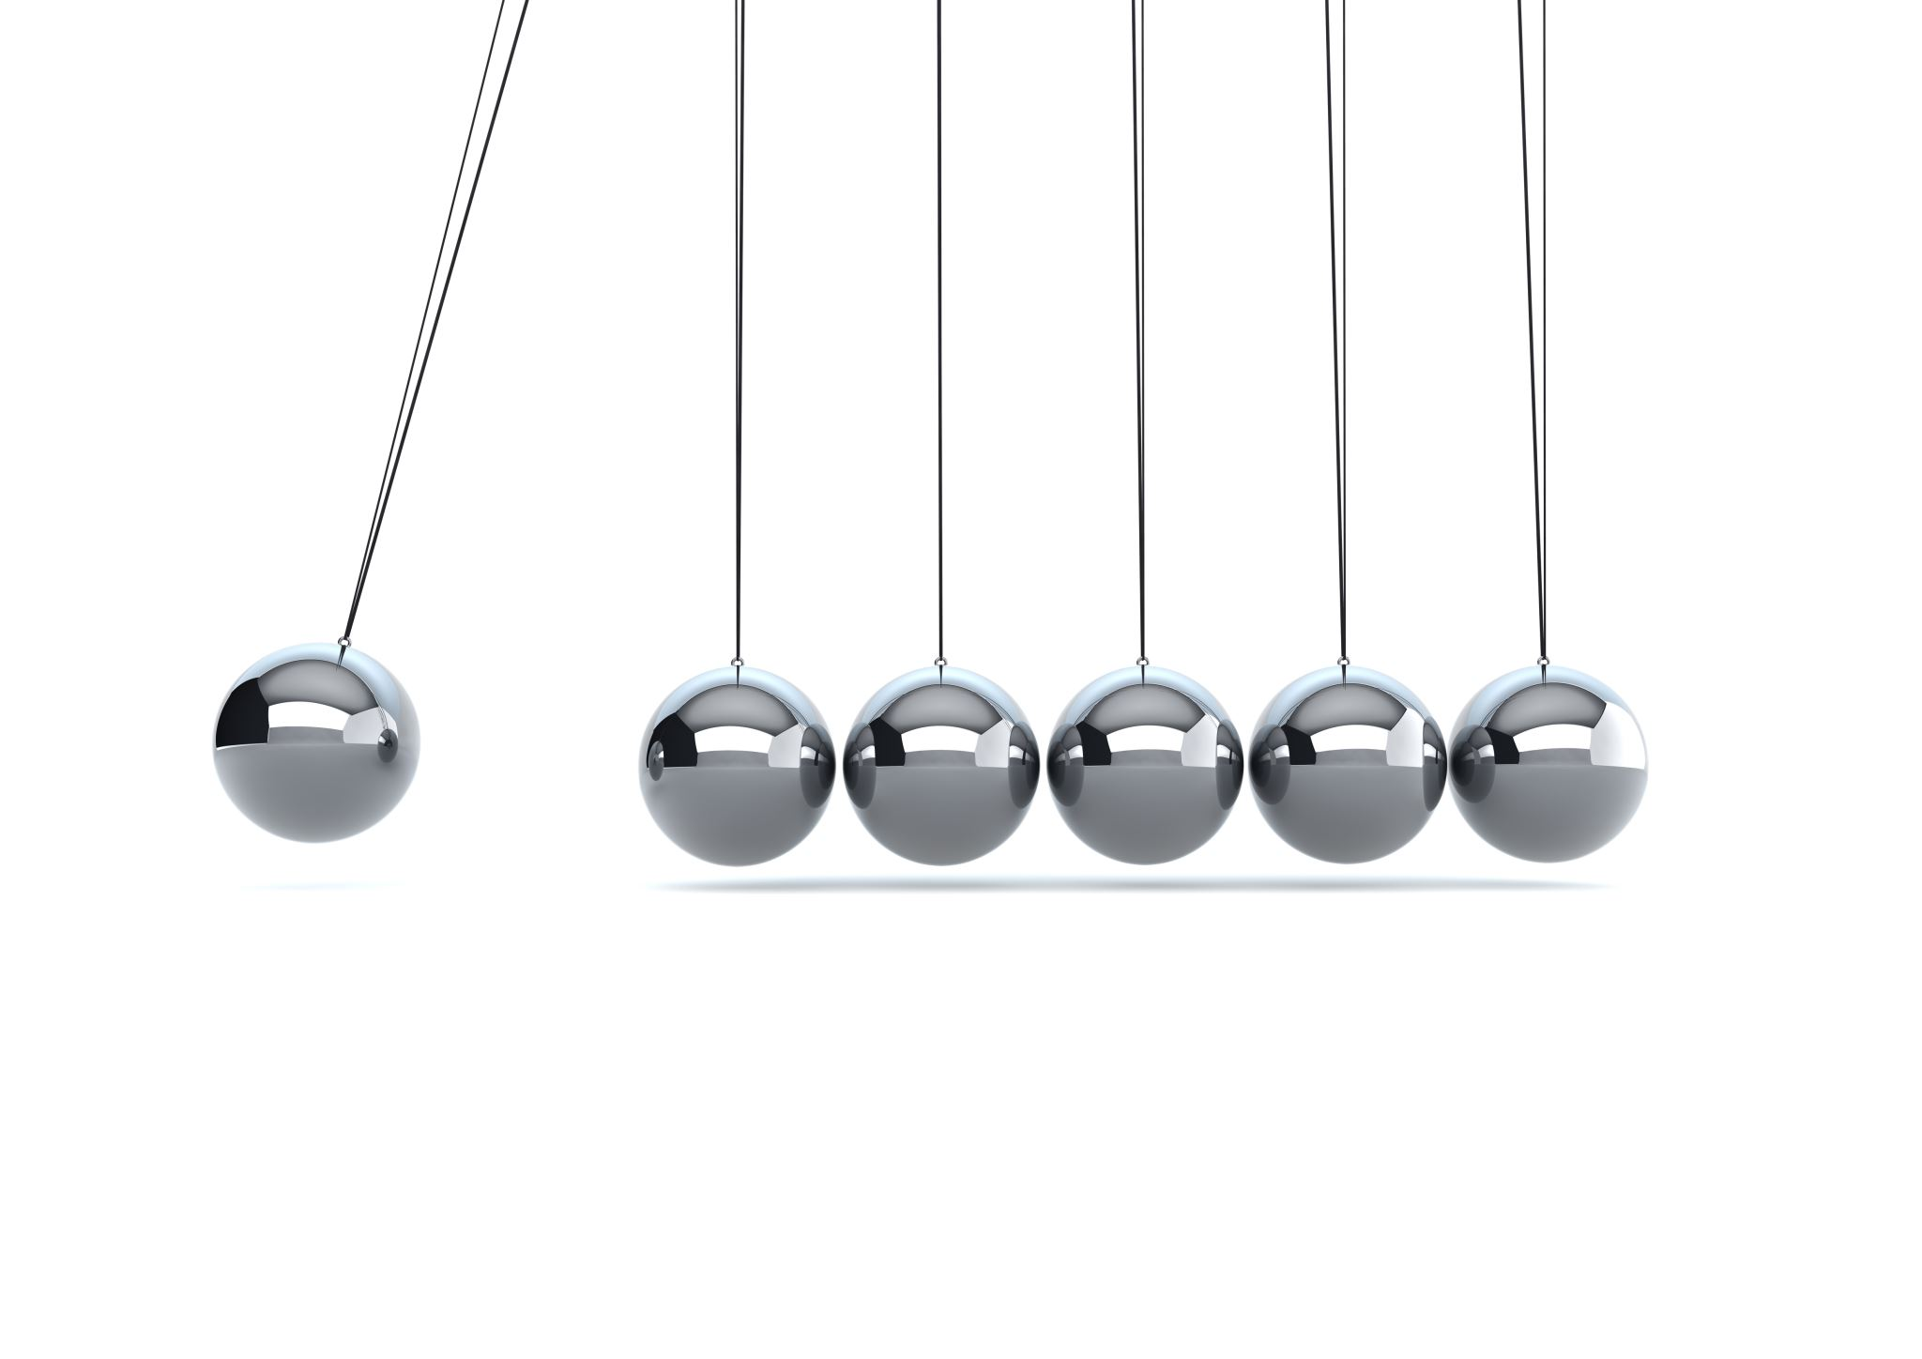
LU Decomposition
A Numerical Method for Solving Linear Systems Efficiently

Slide 2

Introduction to LU Decomposition
LU decomposition factors a square matrix A into L and U:
L → Lower triangular matrix (1s on diagonal)
U → Upper triangular matrix
Solve Equations Efficiently
Compute Inverses & Determinants
Simplify Repeated Calculations

Slide 3




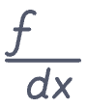

Use Cases & Benefits
Reduces Computational Cost
Improves Precision
Multiple Right-Hand Sides
Optimizes calculations, especially for large matrices.
Offers greater accuracy compared to direct Gaussian methods.
Efficiently solves AX = B for various B vectors.

Slide 4
LU Decomposition: Beyond Gaussian Elimination
Modular Components
Enhanced Efficiency
Numerical Stability
Avoids repeating operations for each new right-hand side vector B, making it faster for multiple systems.
accurate for solving large systems of linear equations.
LU separates the matrix into reusable L and U factors, unlike Gaussian Elimination.

Slide 5




Purpose & Mathematical Representation
Structured Solution
Substitute & Simplify
Provides a clear, two-step process for AX = B.
Replace A with LU: LUX = B. Let UX = Y.
1. Forward Substitution
2. Backward Substitution
Solve for Y efficiently due to L's lower triangular form.
Solve for X efficiently due to U's upper triangular form.

Slide 6


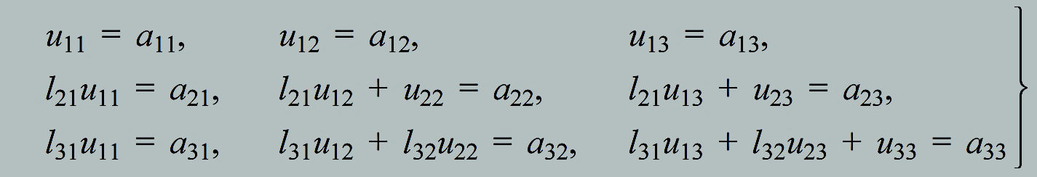
Steps of LU Decomposition (3x3 Matrix)
Given a matrix A:
01
02
Assume L & U Structure
Multiply LU & Equate to A
Define L as lower triangular with 1s on diagonal and U as upper triangular.
Perform the matrix multiplication LU and set it equal to A.
03
Compare Elements
Solve for the unknown lij and uij values.
04
Solve Systems
Once L and U are known, solve LY = B (forward) then UX = Y (backward).

Slide 7



Example with Solution (3x3 System)
Given System:
Which corresponds to the equations:
2x1 + 3x2 + 1x3 = 7
4x1 + 7x2 + 7x3 = 11
-2x1 + 4x2 + 5x3 = 1
Step 1: LU Decomposition

Slide 8


Step 2: Forward Substitution
Solving LY = b
y1 = 7
2y1 + y2 = 11 → y2 = 11 - 2(7) = -3
-y1 + 7y2 + y3 = 1 → y3 = 1 - (-7) - 7(-3) = 1 + 7 + 21 = 29
Resulting Y Vector:

Slide 9


Step 3: Backward Substitution
Solving UX = Y
-29x3 = 29 → x3 = -1
x2 + 5x3 = -3 → x2 + 5(-1) = -3 → x2 = 2
2x1 + 3x2 + x3 = 7 → 2x1 + 3(2) + (-1) = 7 → 2x1 + 6 - 1 = 7 → 2x1 = 2 → x1 = 1
Final Solution:

Slide 10

Thank You
Presented by
Abdullah Al Mahfuz
241311058
Section ‘B’
"Mathematics gives us the power to decompose complexity into simplicity."

